Slide 1


Deploy your first bot
Four ways to put a strategy to work — easiest one first.
Paper money only. Real prices. Honest numbers.
QUANTRADIN

Slide 2
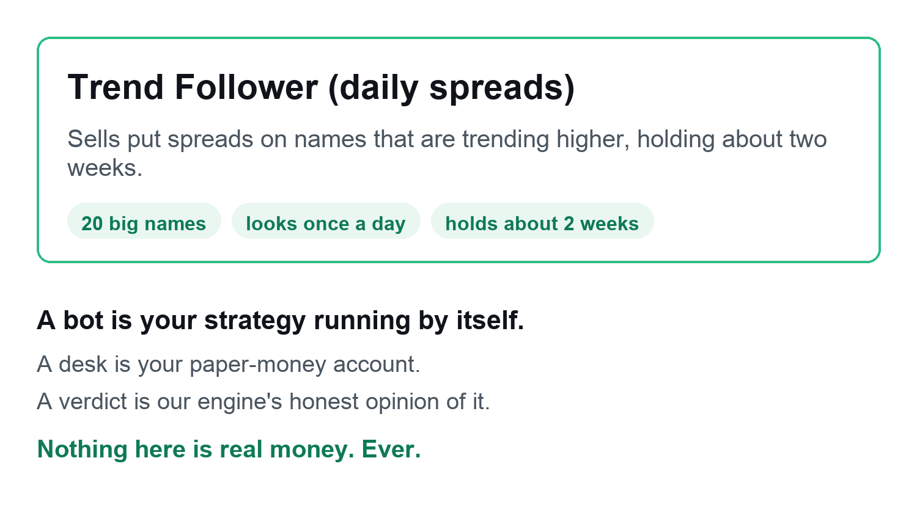
THE BOT
What you'll build
One bot. Four ways to put it to work.
Quantradin · Deploy your first bot
2 / 35

Slide 3
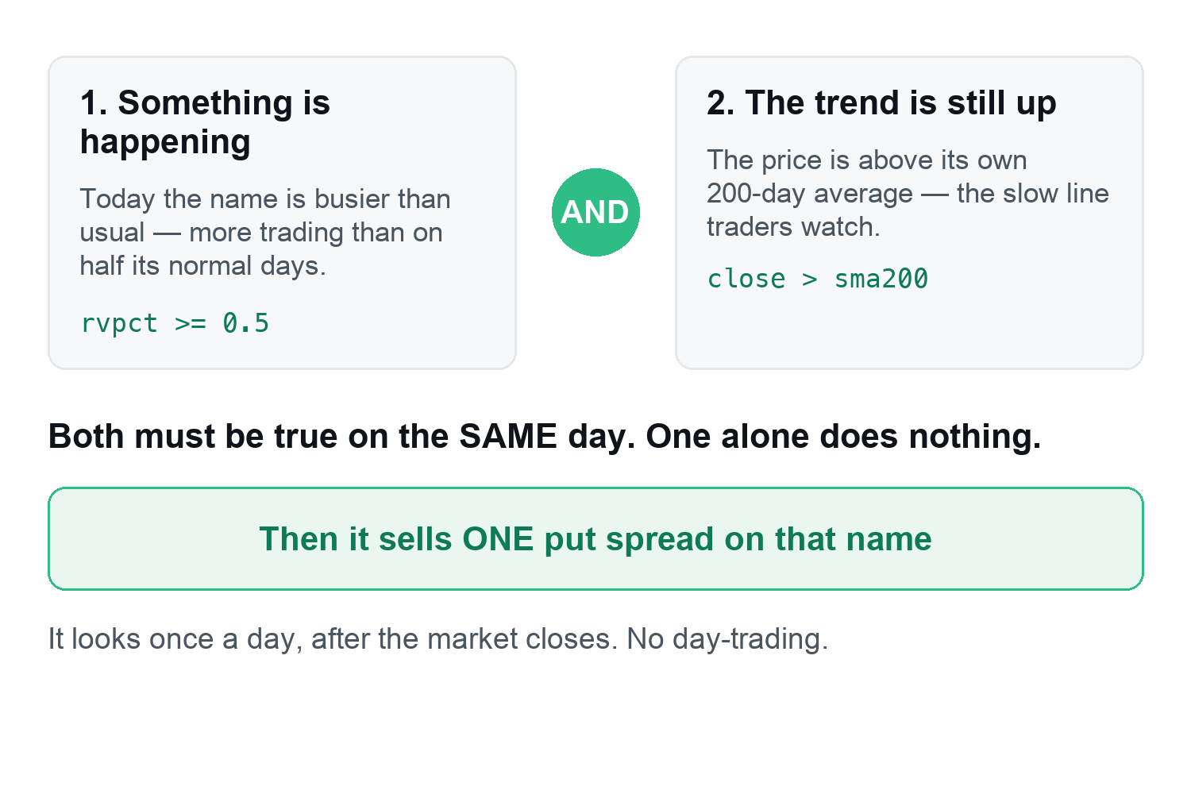
HOW THE BOT THINKS
It waits for two things
Quantradin · Deploy your first bot
3 / 35

Slide 4
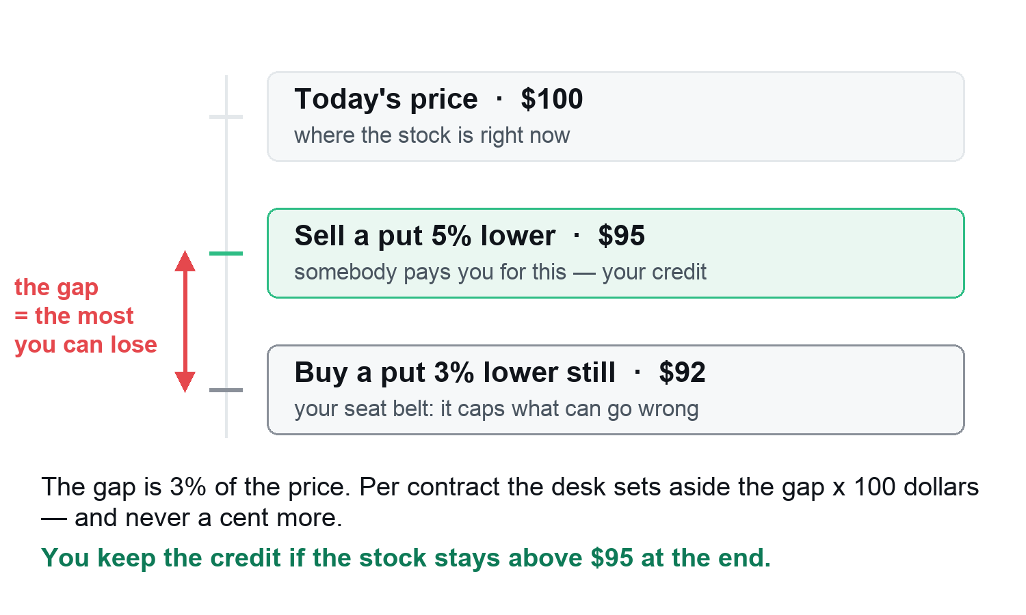
HOW THE BOT THINKS
What it actually sells
Quantradin · Deploy your first bot
4 / 35

Slide 5
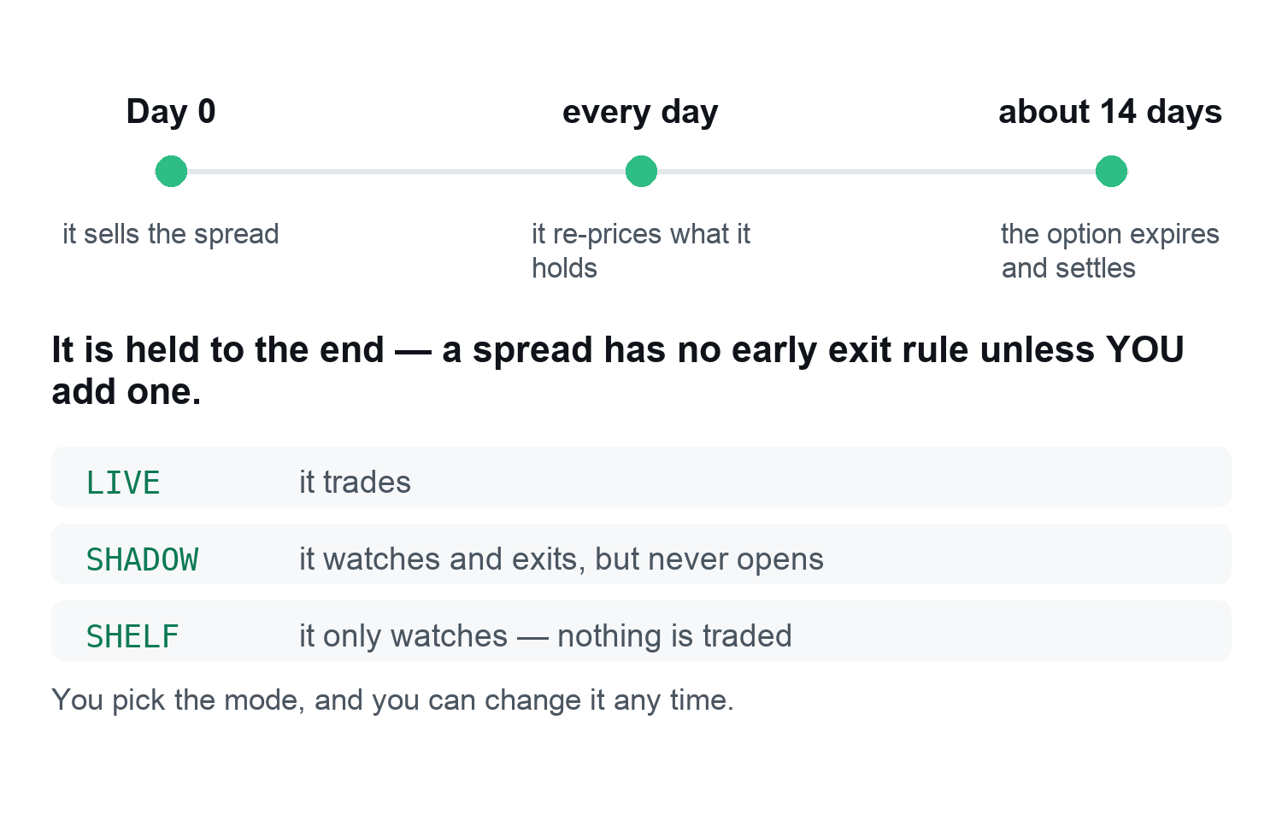
HOW THE BOT THINKS
How a trade ends
Quantradin · Deploy your first bot
5 / 35

Slide 6
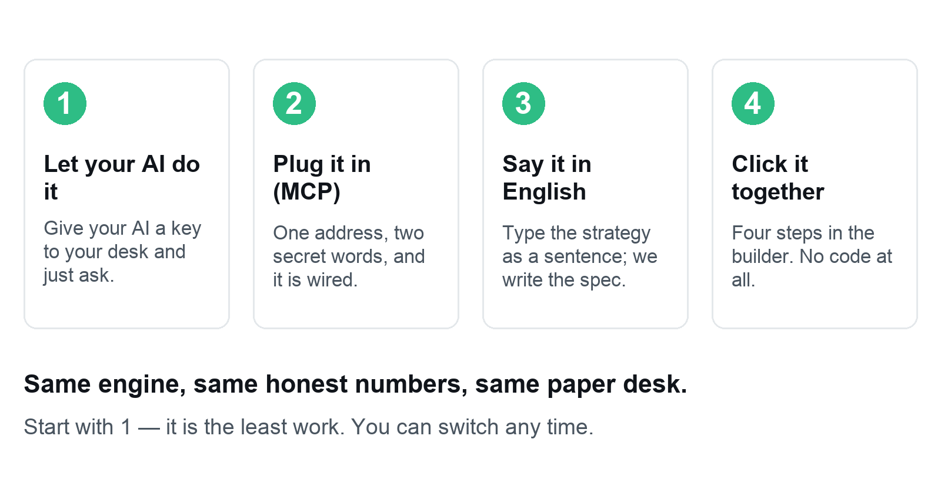
PICK ONE
Four ways to put it to work
Quantradin · Deploy your first bot
6 / 35

Slide 7

WAY 1
Let your AI do it
The easiest way. You give your AI a key to one paper desk, and ask.
7 / 35

Slide 8
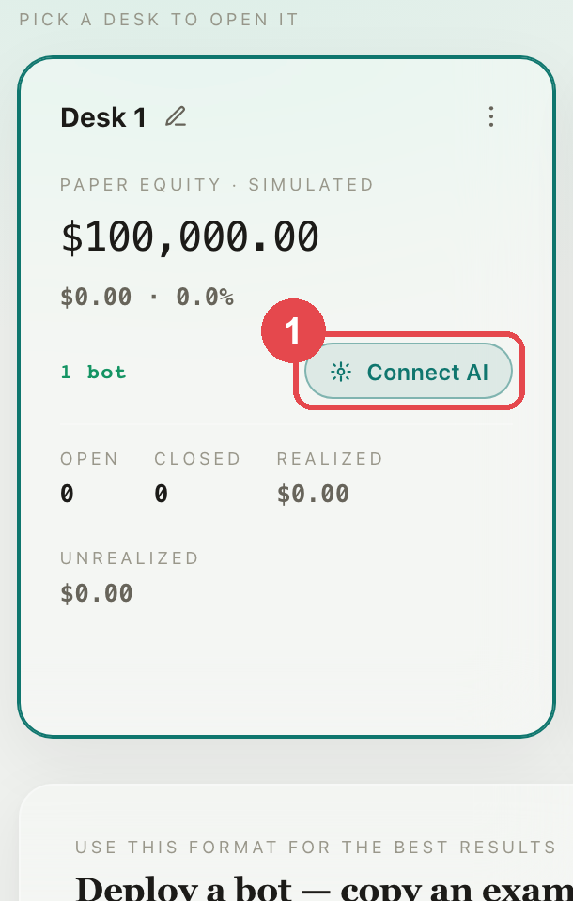
WAY 1 · LET YOUR AI DO IT
Open your desks
STEP 1
On Desks, pick one desk and click Connect AI.
Quantradin · Deploy your first bot
8 / 35

Slide 9
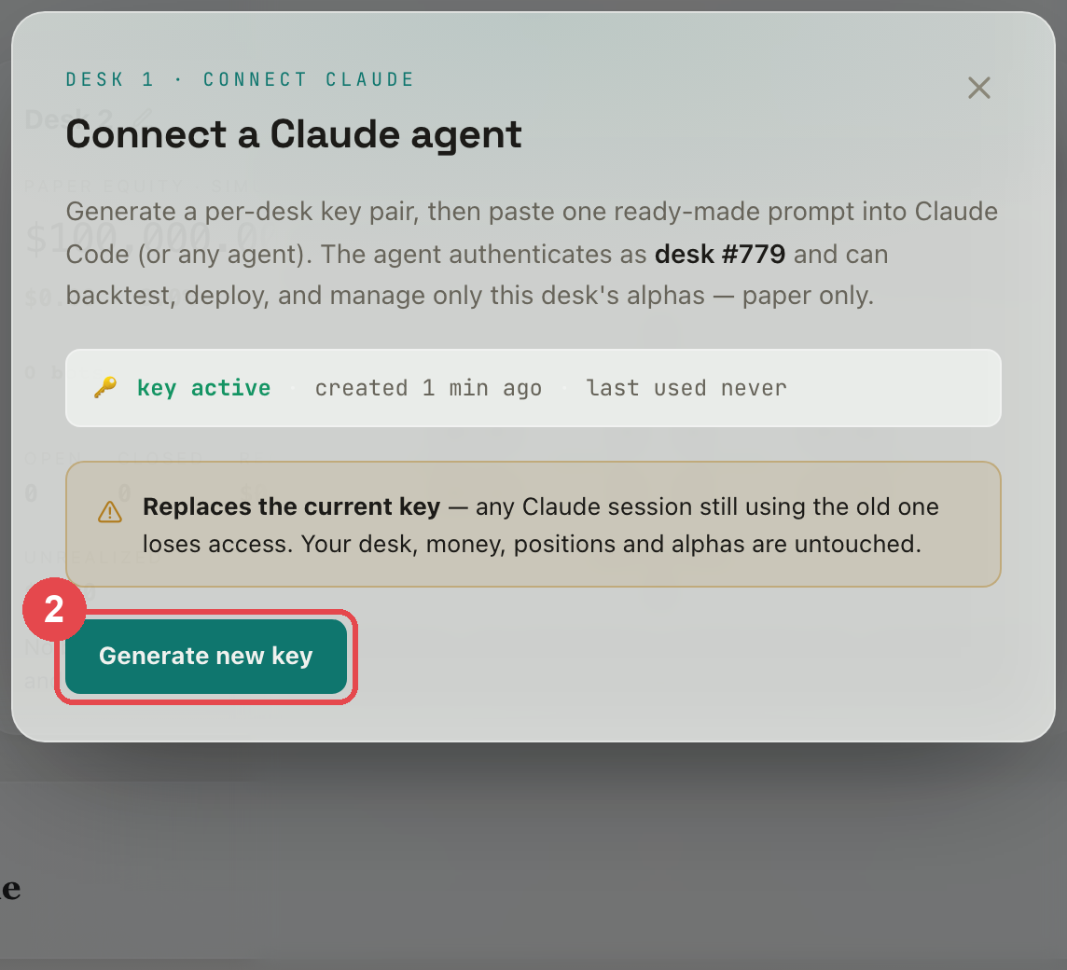
WAY 1 · LET YOUR AI DO IT
Make the desk's key
STEP 2
One key pair per desk. It can never touch another desk, and it is paper money.
Quantradin · Deploy your first bot
9 / 35

Slide 10
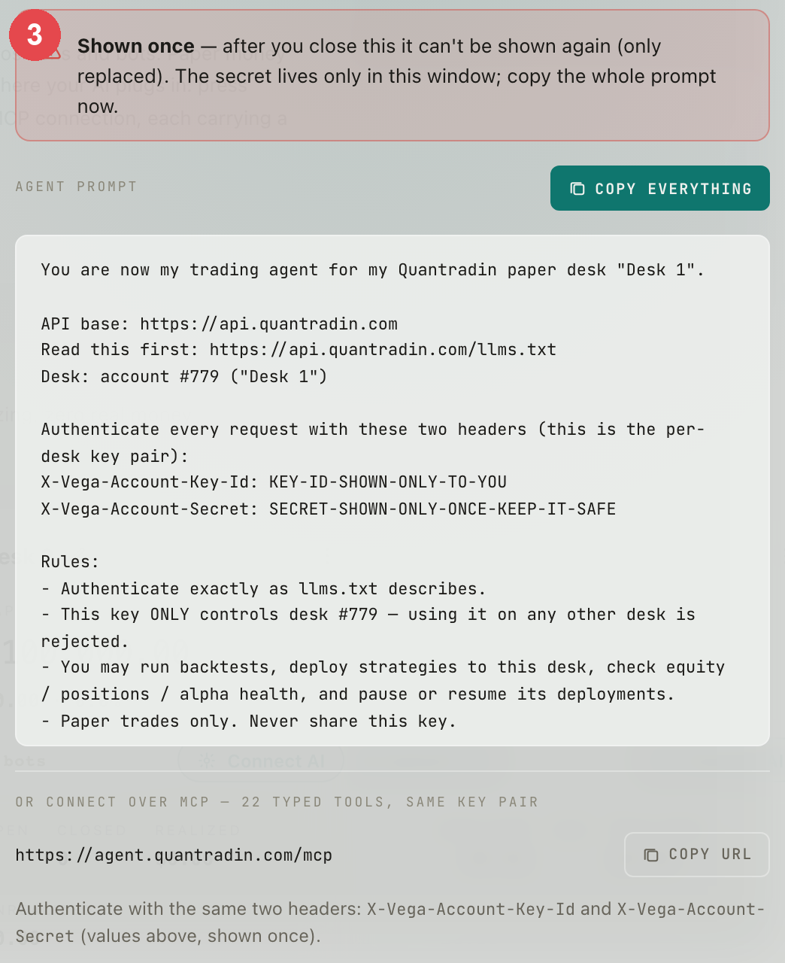
WAY 1 · LET YOUR AI DO IT
Copy the ready-made prompt
STEP 3
Paste it into Claude or ChatGPT. It explains your desk and the rules. The secret is shown once.
Quantradin · Deploy your first bot
10 / 35

Slide 11
WAY 1 · LET YOUR AI DO IT
Now give your AI our strategy
STEP 4
Paste this next. Your AI does the rest — on YOUR desk, with paper money.
Backtest this strategy honestly and deploy it to my desk:
{ "name": "Trend Follower (daily spreads)", "asset_class": "credit",
"timeframe": "1 day",
"universe": ["SPY","QQQ","IWM","DIA","AAPL","MSFT","GOOGL","AMZN","NVDA","META",
"JPM","V","MA","COST","WMT","UNH","HD","XOM","JNJ","PG"],
"backtest": { "start": "2024-02-12", "end": "2026-05-20" },
"entry": { "side": "put", "when": { "all": [ { "gte": ["rvpct", 0.5] },
{ "gt": ["close", "sma200"] } ] } },
"exit": { "rule": "fixed", "hold_days": 14 },
"structure": { "type": "put_spread", "otm_pct": 0.05, "wing_pct": 0.03,
"target_dte": 14 } }
Quantradin · Deploy your first bot
11 / 35

Slide 12
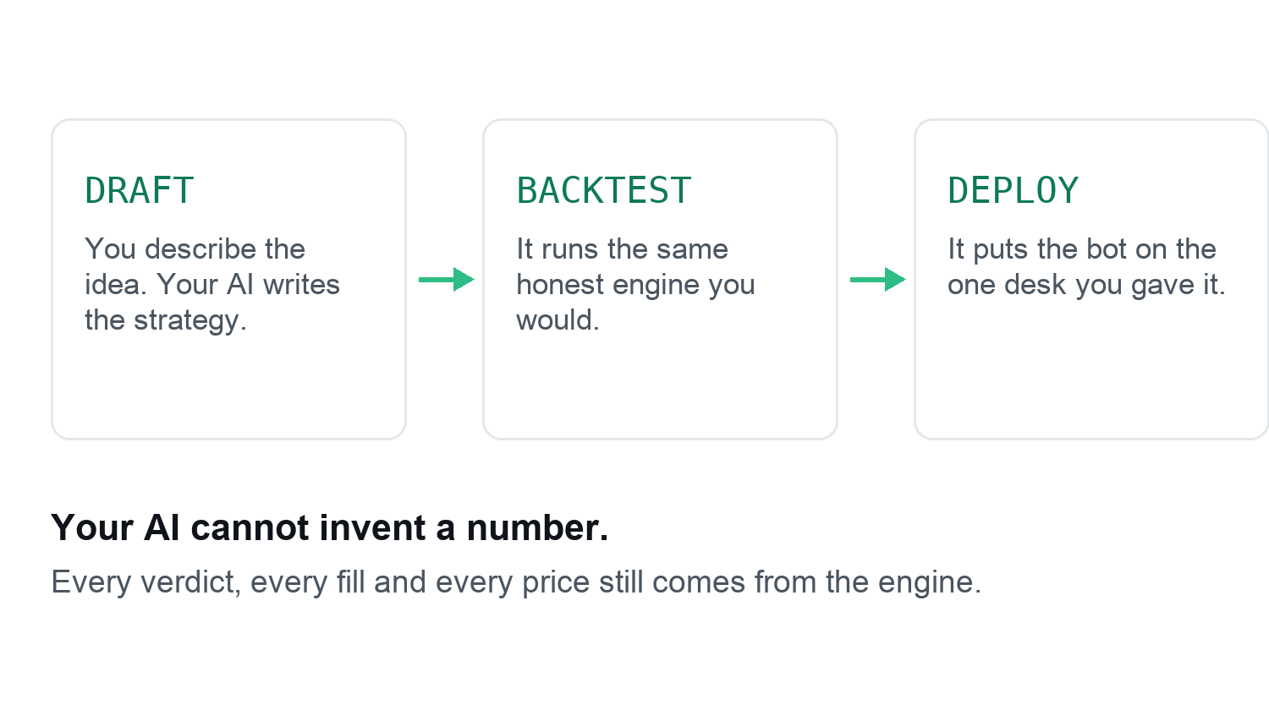
WAY 1 · LET YOUR AI DO IT
What your AI does next
Quantradin · Deploy your first bot
12 / 35

Slide 13
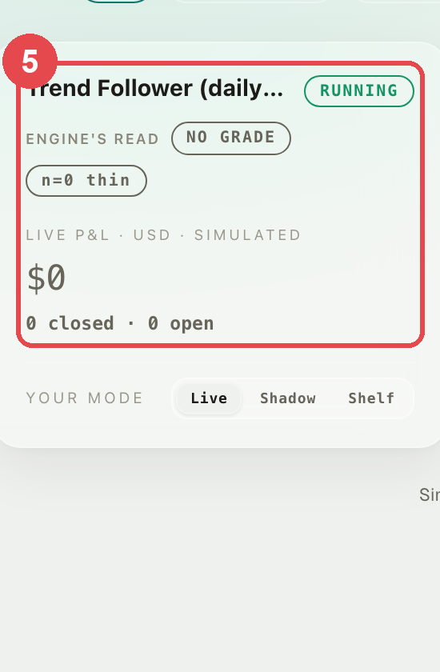
WAY 1 · LET YOUR AI DO IT
And the bot is on your desk
STEP 5
You did not open the builder once. It is yours, and you can switch it off any time.
Quantradin · Deploy your first bot
13 / 35

Slide 14
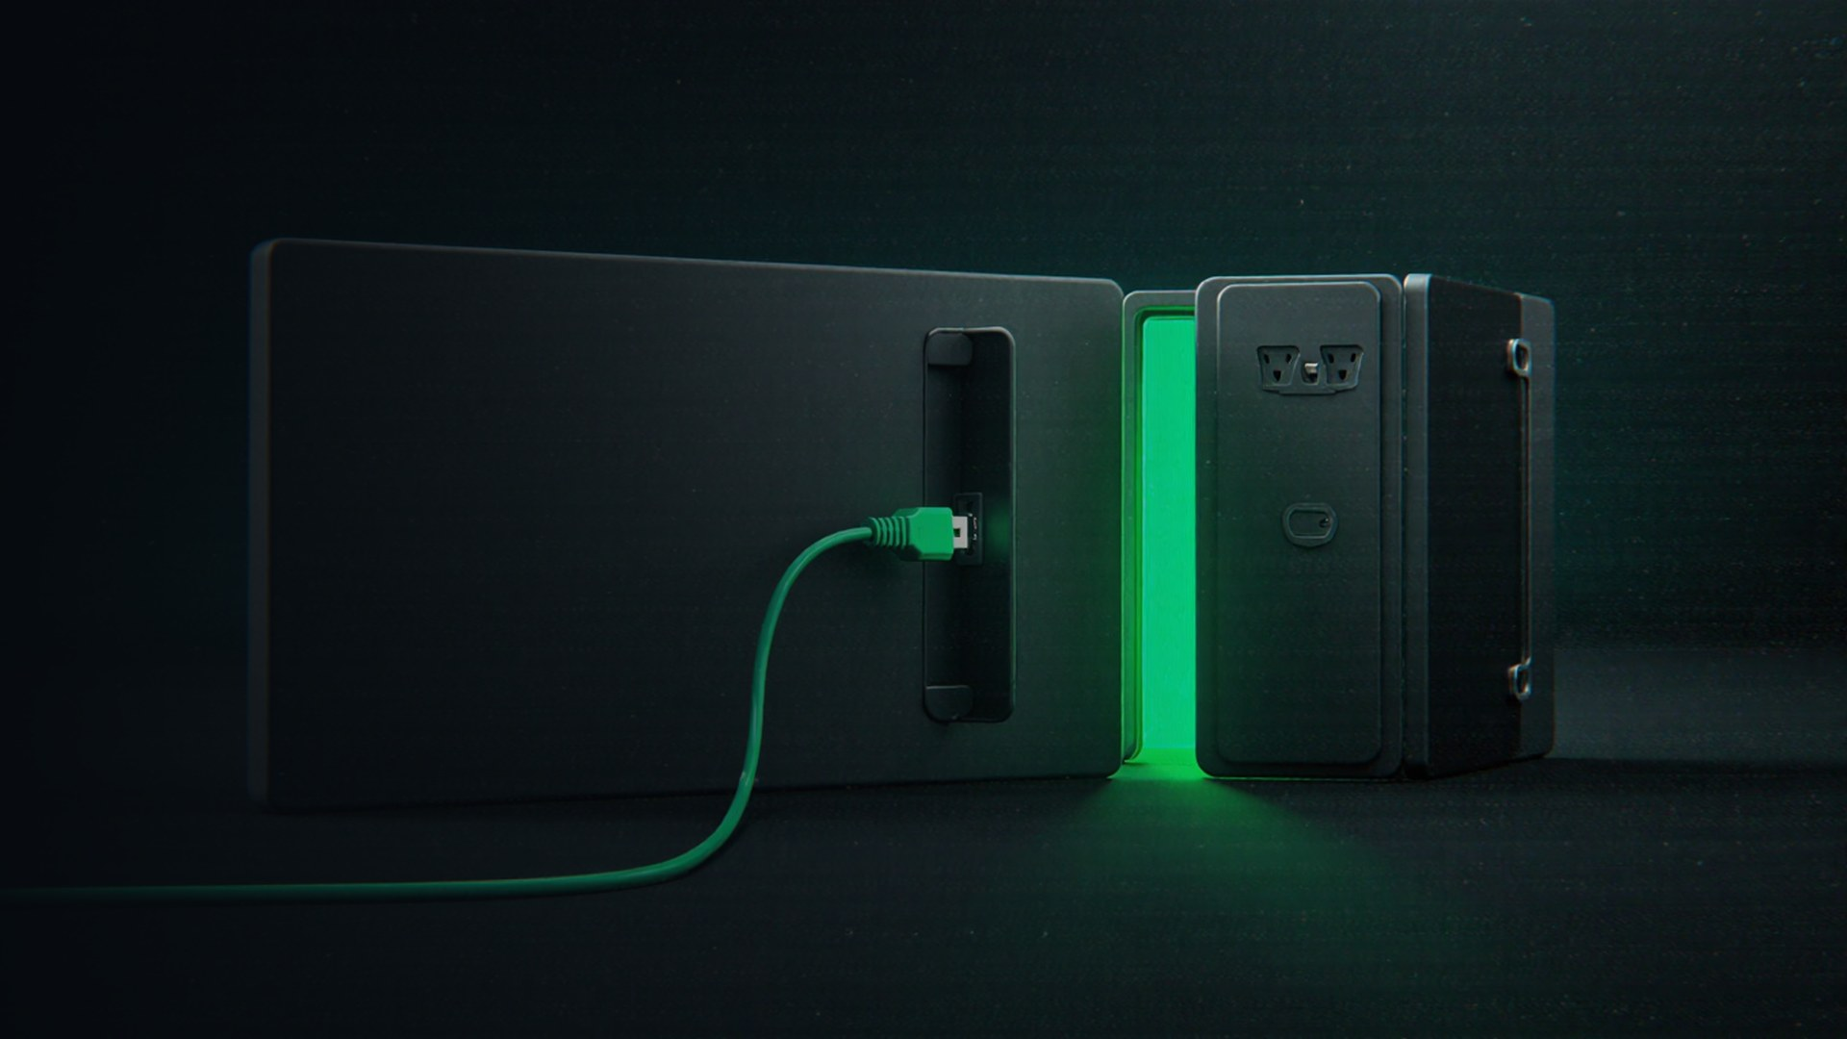
WAY 2
Plug it in (MCP)
MCP is a socket for AI assistants: one address plus two secret words.
Your AI then uses the desk itself, instead of copying numbers about.
14 / 35

Slide 15
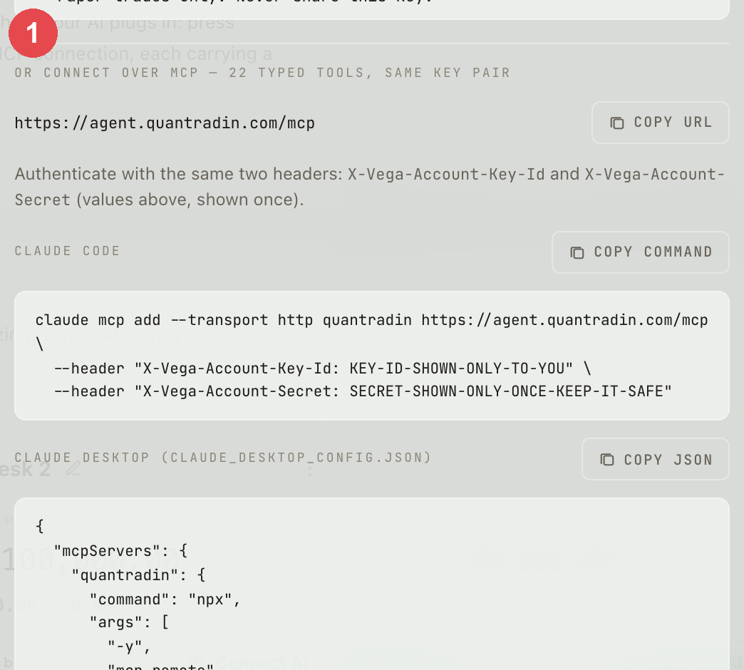
WAY 2 · PLUG IT IN (MCP)
Wire it in one line
STEP 1
One command for Claude Code, one JSON block for Claude Desktop — the same key pair from Way 1.
Quantradin · Deploy your first bot
15 / 35

Slide 16

WAY 3
Say it in English
Type the strategy the way you would say it out loud.
We turn it into a real, runnable strategy — you check it before it runs.
16 / 35

Slide 17
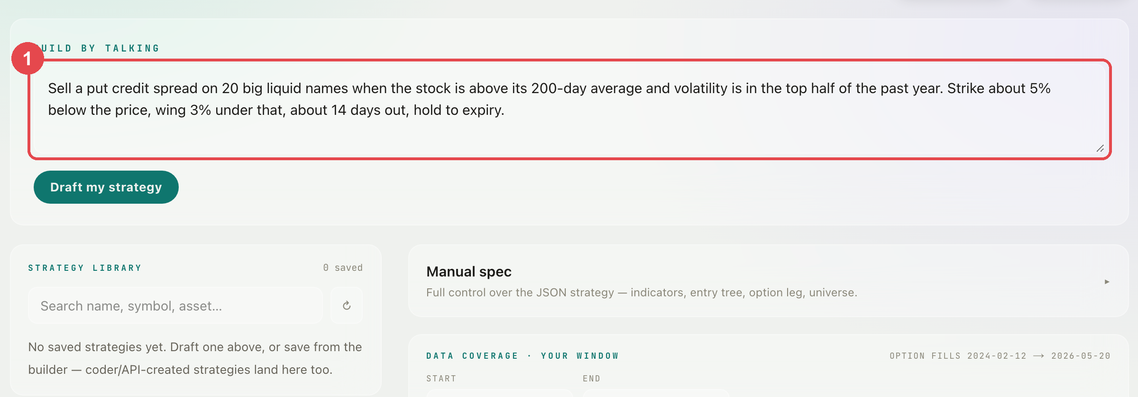
WAY 3 · SAY IT IN ENGLISH
Type it, plainly
STEP 1
No code words needed. Say what to trade, when to buy, and when to get out.
Quantradin · Deploy your first bot
17 / 35

Slide 18
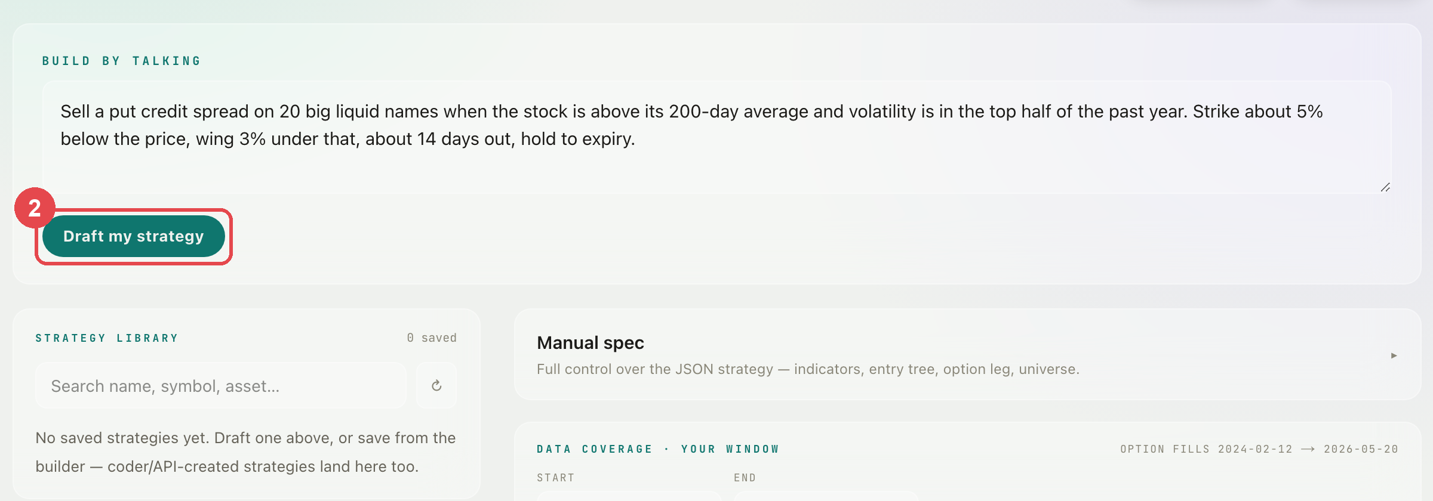
WAY 3 · SAY IT IN ENGLISH
Ask it to draft
STEP 2
Press Draft my strategy.
Quantradin · Deploy your first bot
18 / 35

Slide 19
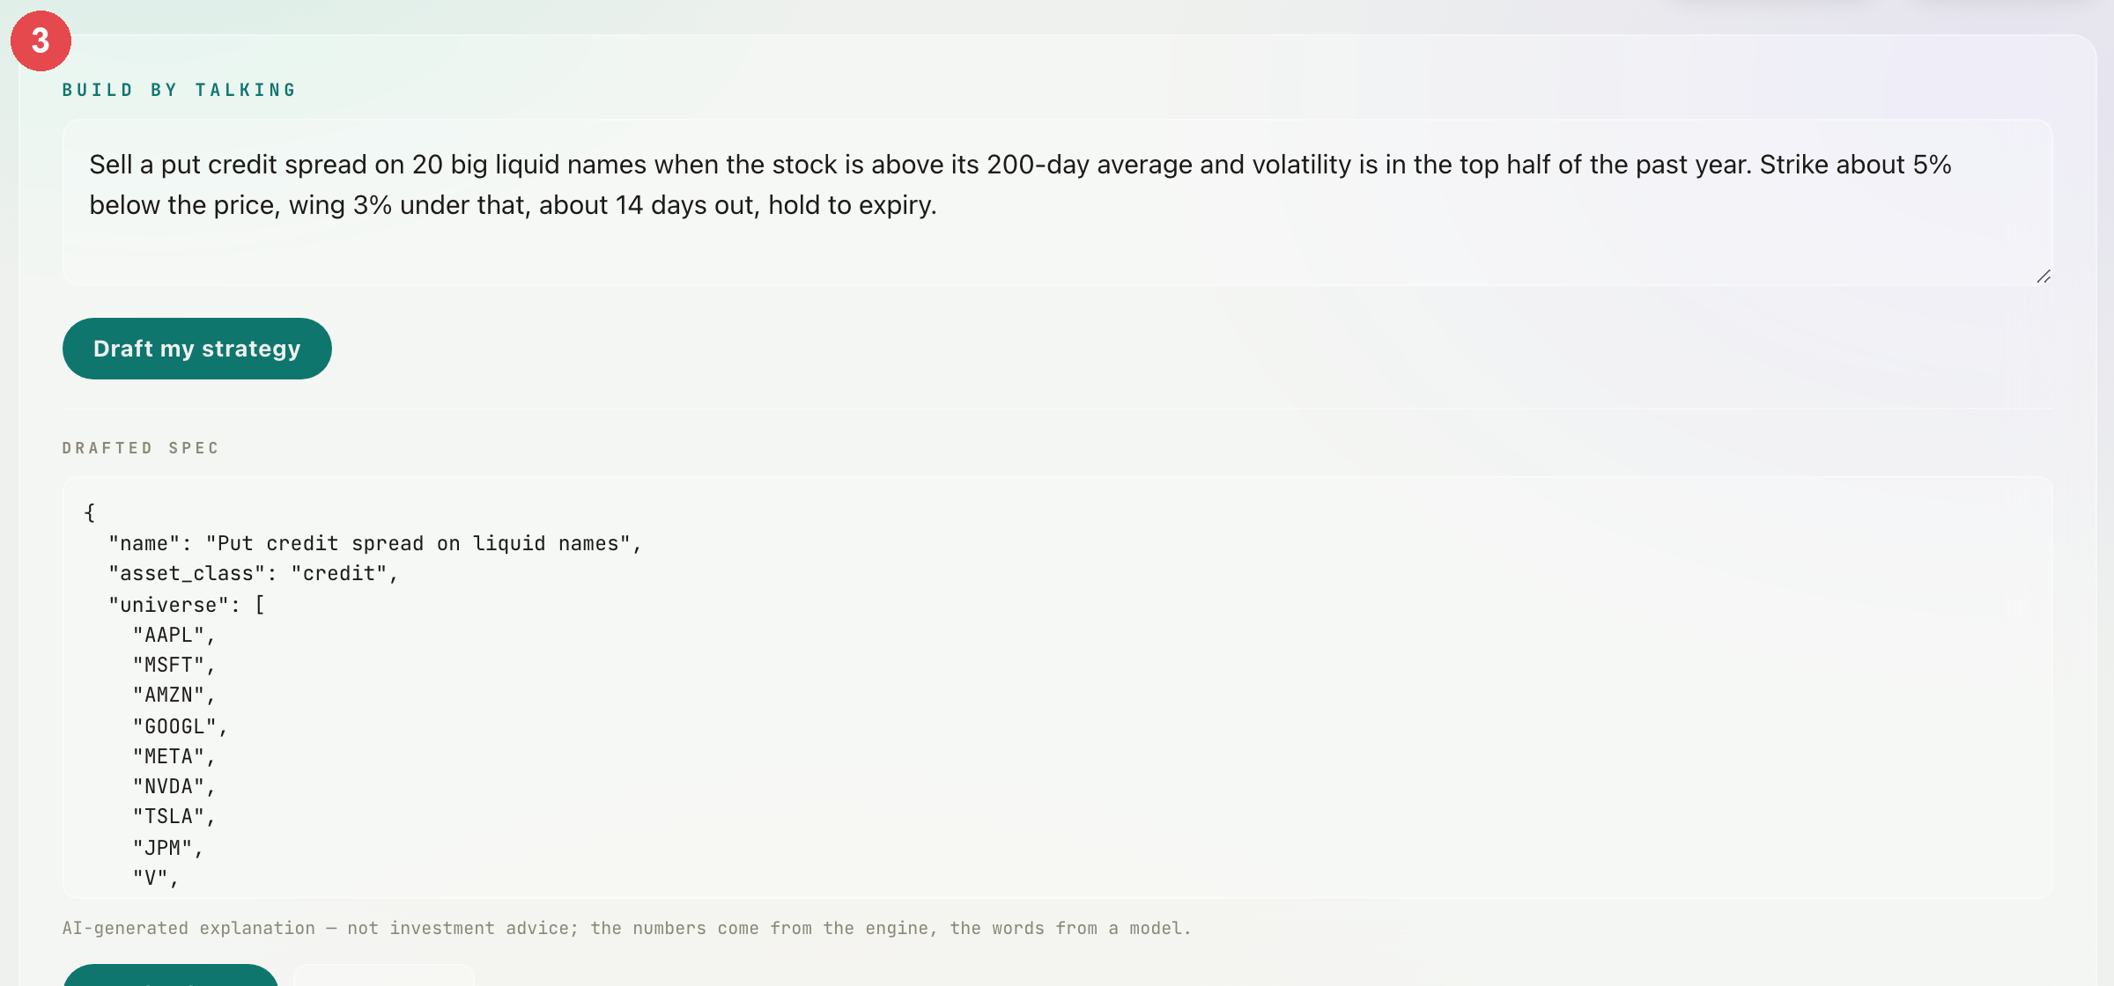
WAY 3 · SAY IT IN ENGLISH
It writes the strategy
STEP 3
Your sentence, turned into the real thing — and dropped straight into the builder.
Quantradin · Deploy your first bot
19 / 35

Slide 20
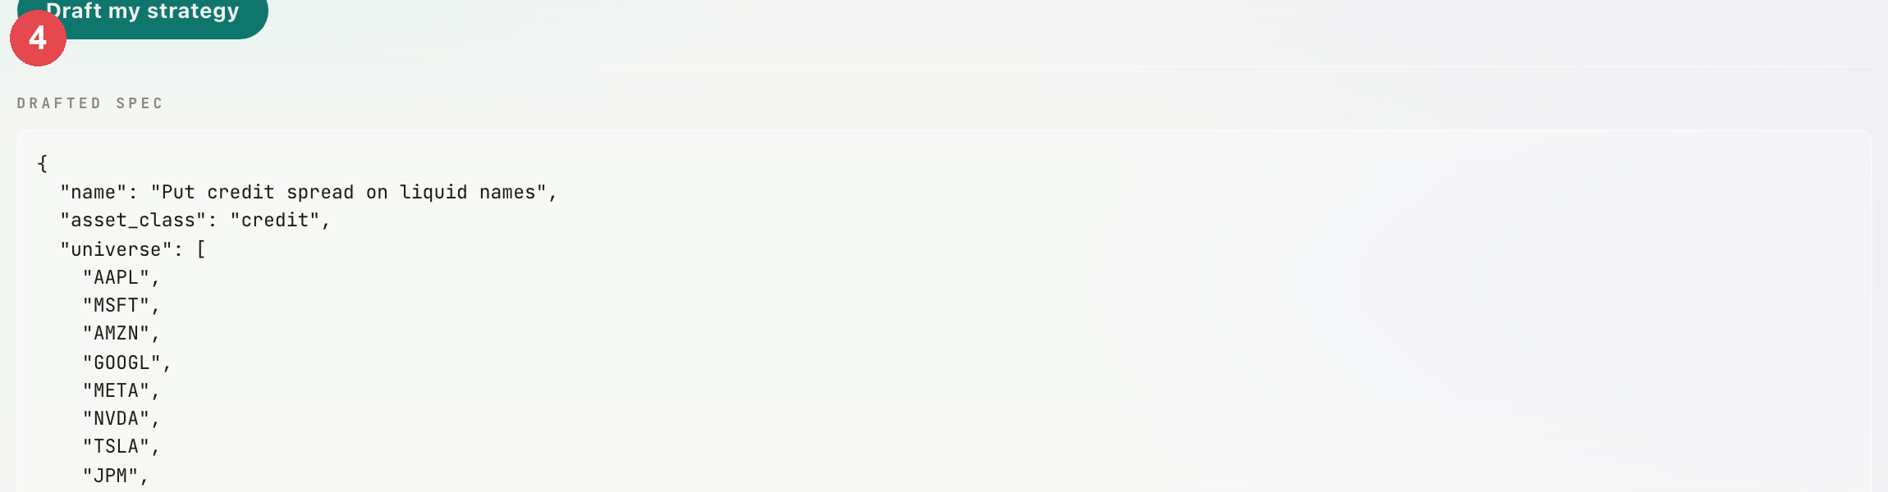
WAY 3 · SAY IT IN ENGLISH
Run it, then deploy it
STEP 4
Same engine, same honest verdict as everything else here.
Quantradin · Deploy your first bot
20 / 35

Slide 21

WAY 4
Click it together
The builder, four numbered steps, no code at all.
This is the long way round — and the one where you see every choice.
21 / 35

Slide 22
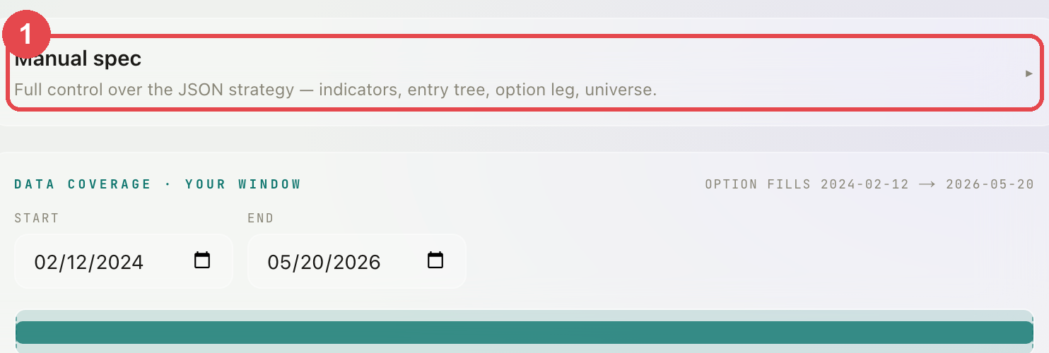
WAY 4 · CLICK IT TOGETHER
Open the builder
STEP 1
On Backtest, open Manual spec — that is the builder.
Quantradin · Deploy your first bot
22 / 35

Slide 23
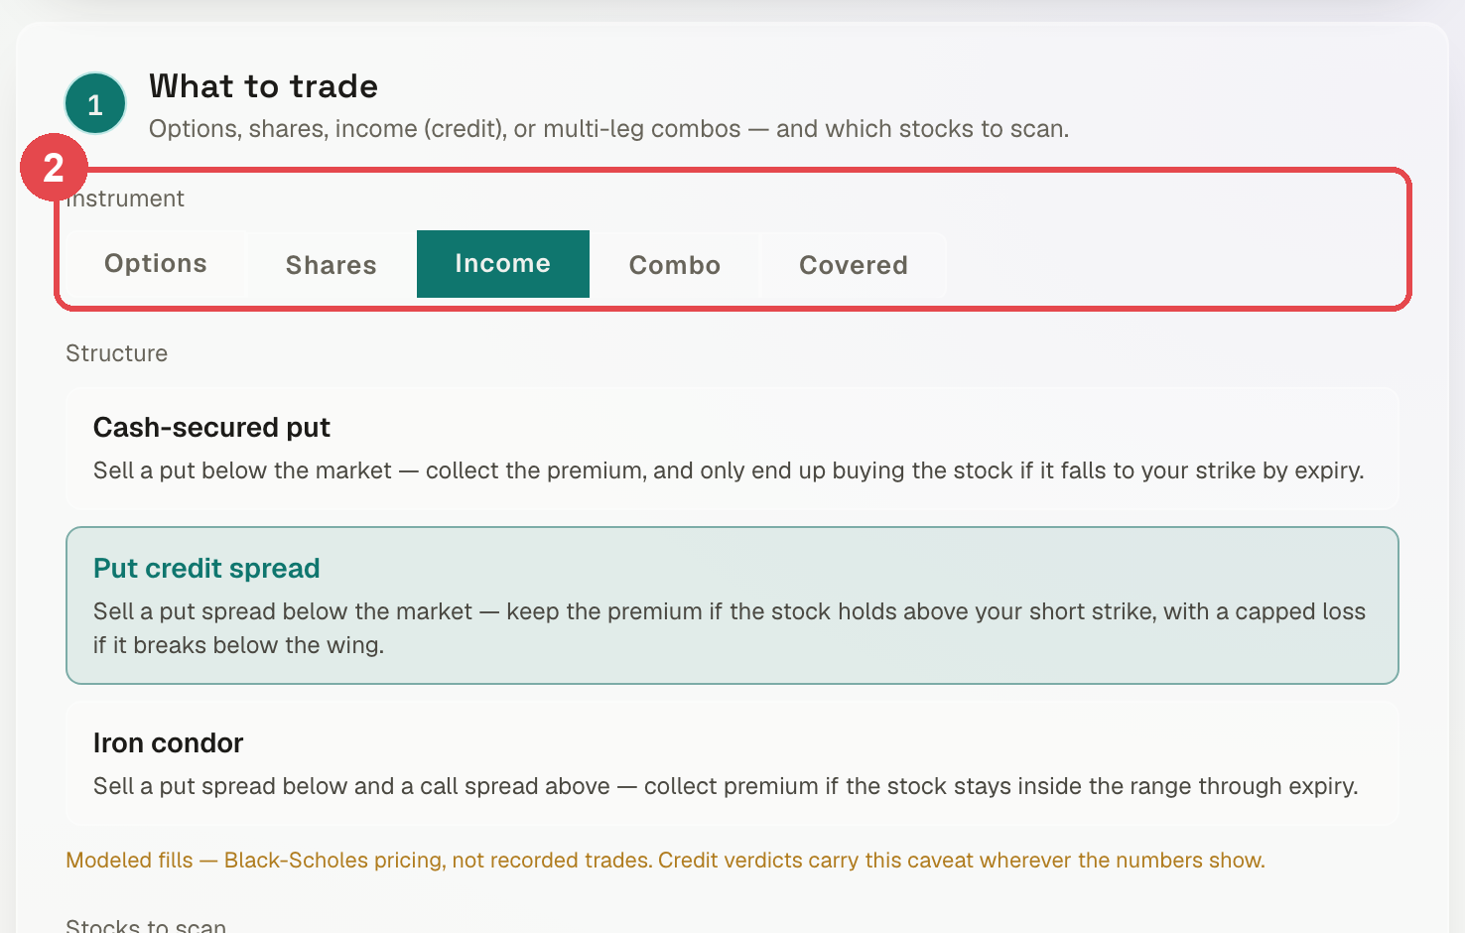
WAY 4 · CLICK IT TOGETHER
Say what you trade
STEP 2
Income (credit) means you sell something and get paid up front. Then pick Put credit spread.
Quantradin · Deploy your first bot
23 / 35

Slide 24
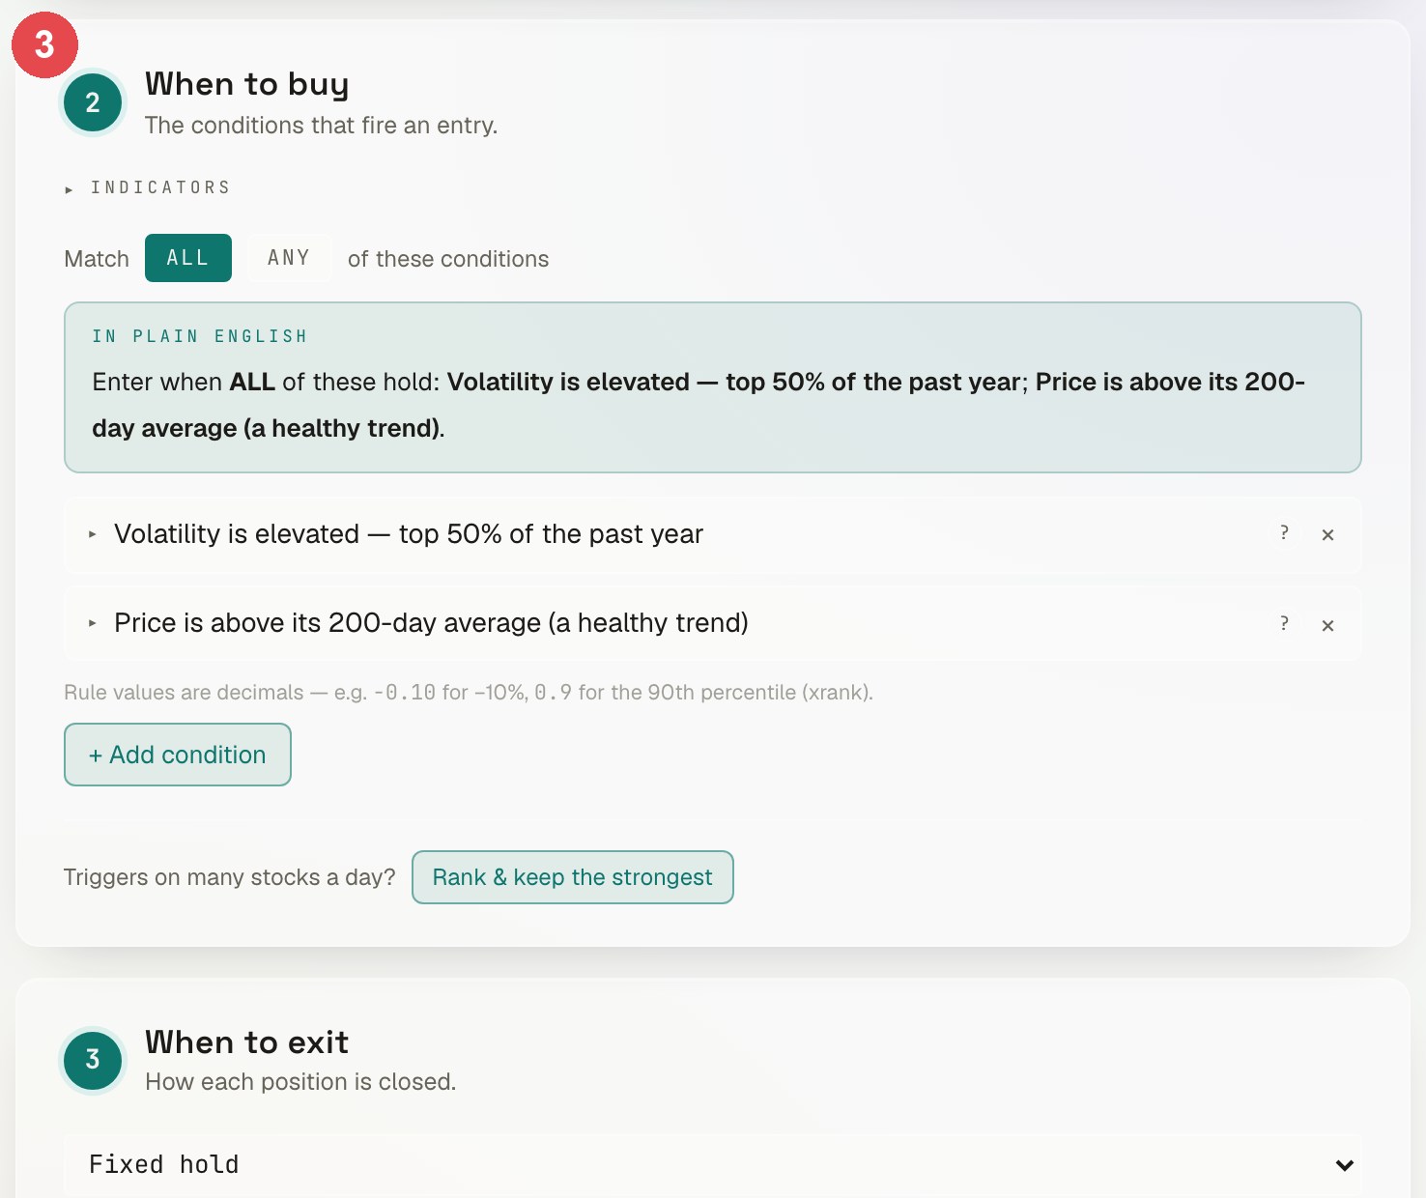
WAY 4 · CLICK IT TOGETHER
Say when it buys
STEP 3
Two conditions, both true on the same day. It repeats them back in plain English.
Quantradin · Deploy your first bot
24 / 35

Slide 25
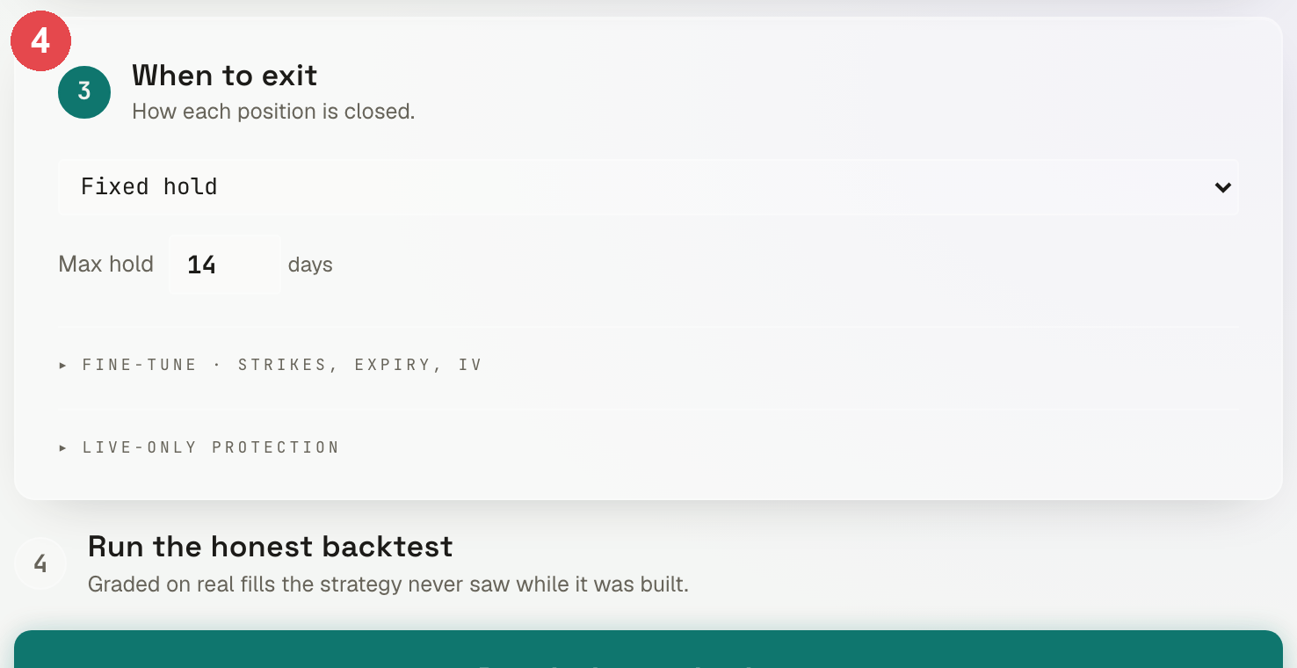
WAY 4 · CLICK IT TOGETHER
Say when it exits
STEP 4
Fixed hold, 14 days — the spread runs to its expiry.
Quantradin · Deploy your first bot
25 / 35

Slide 26
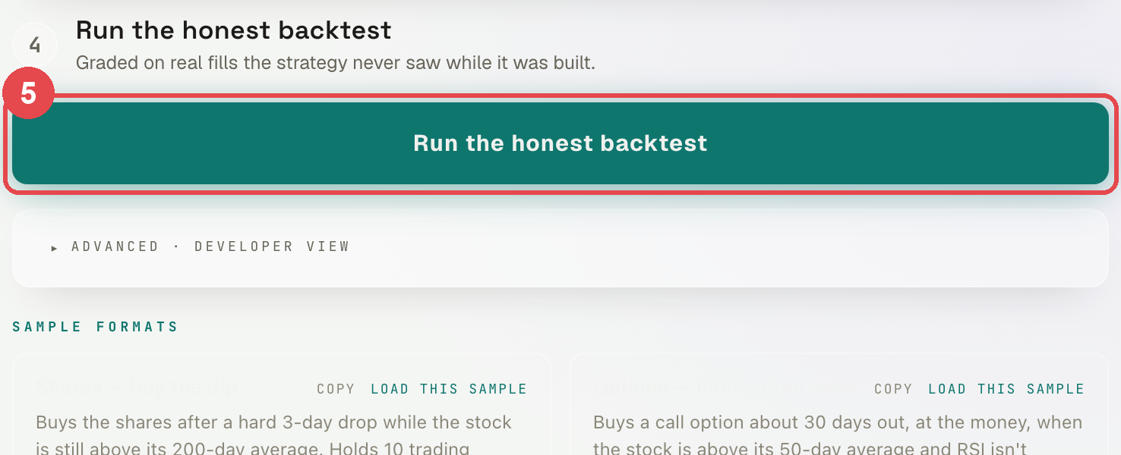
WAY 4 · CLICK IT TOGETHER
Run the honest backtest
STEP 5
It is graded on real prices it never saw while you were building it.
Quantradin · Deploy your first bot
26 / 35

Slide 27
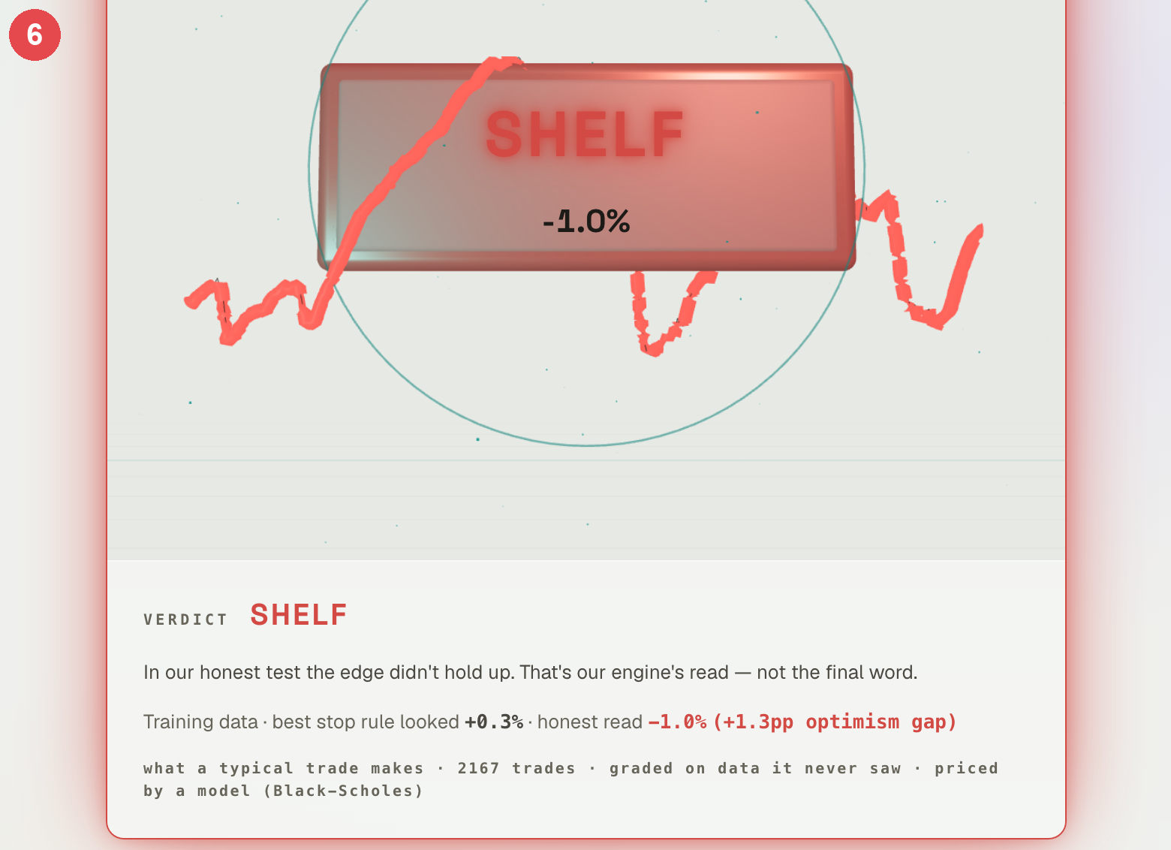
WAY 4 · CLICK IT TOGETHER
Read the verdict
STEP 6
LIVE, SHADOW or SHELF is our engine's read — never a lock on the door.
Quantradin · Deploy your first bot
27 / 35

Slide 28
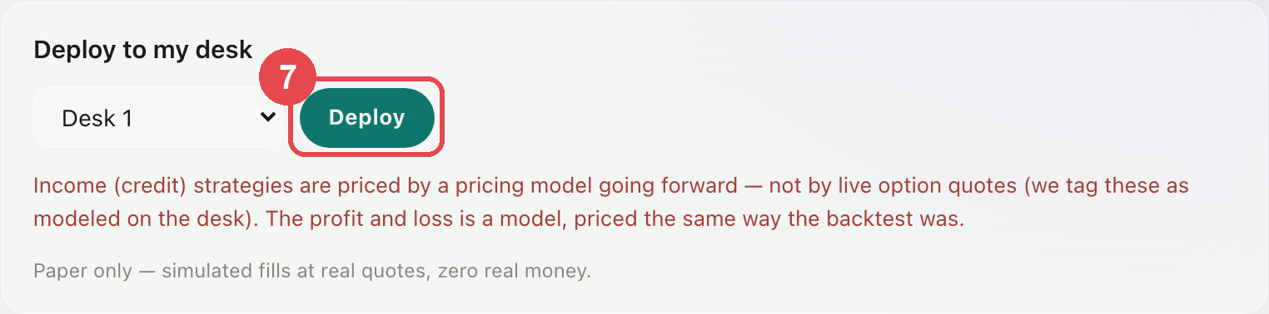
WAY 4 · CLICK IT TOGETHER
Send it to your desk
STEP 7
Pick a desk and press Deploy. You decide; the verdict only advises.
Quantradin · Deploy your first bot
28 / 35

Slide 29
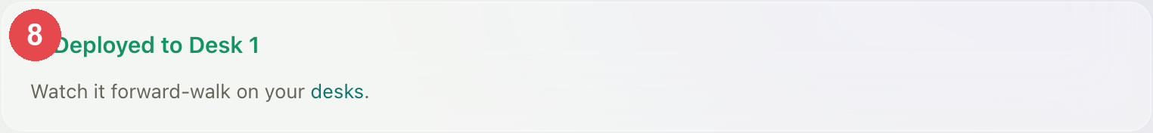
WAY 4 · CLICK IT TOGETHER
It is working
STEP 8
From here it walks forward on its own, on paper money.
Quantradin · Deploy your first bot
29 / 35

Slide 30

AFTER
After you deploy
However you got here, the bot is now yours to watch — and to stop.
30 / 35

Slide 31
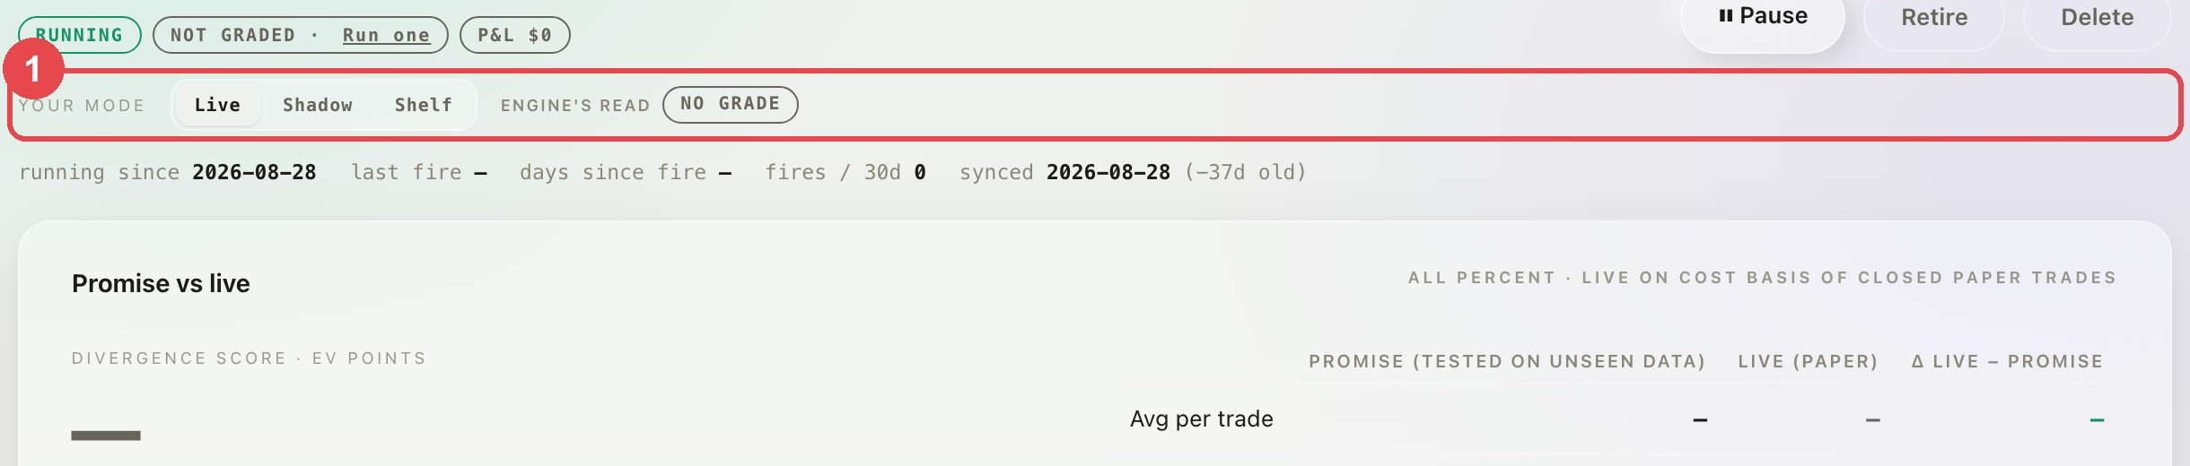
AFTER YOU DEPLOY
Your bot's own page
STEP 1
Live trades · Shadow watches and exits · Shelf only watches.
Quantradin · Deploy your first bot
31 / 35

Slide 32
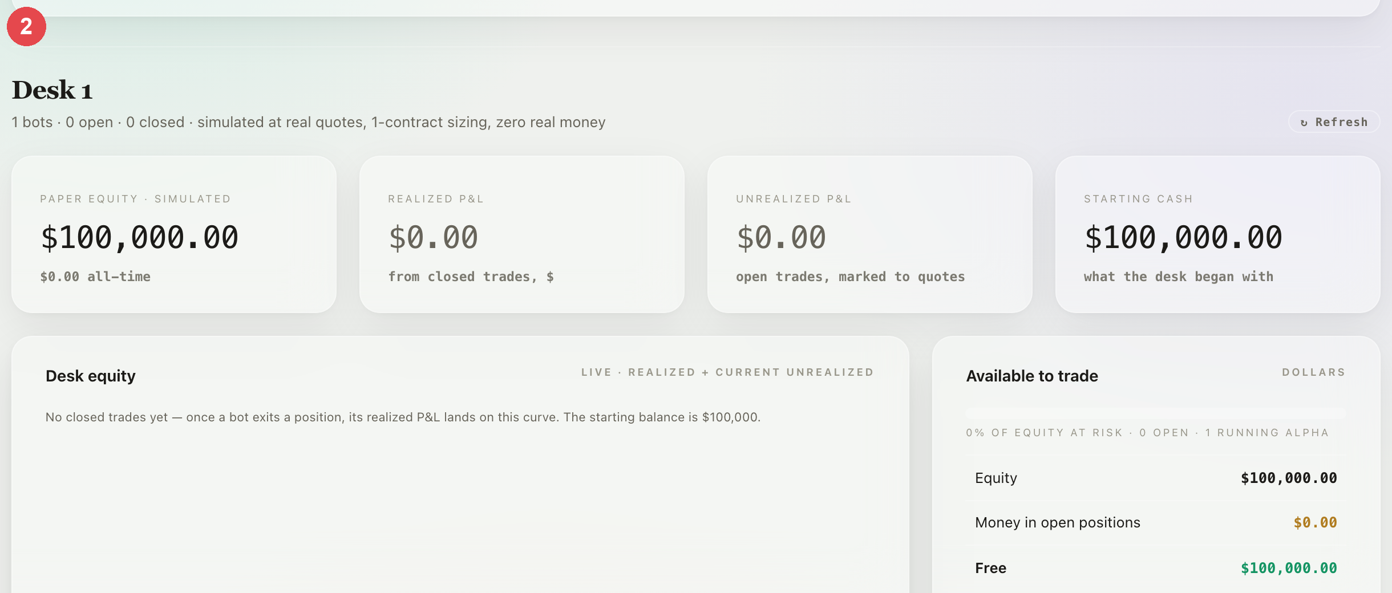
AFTER YOU DEPLOY
The desk it lives on
STEP 2
Your paper cash, and every bot working on it.
Quantradin · Deploy your first bot
32 / 35

Slide 33
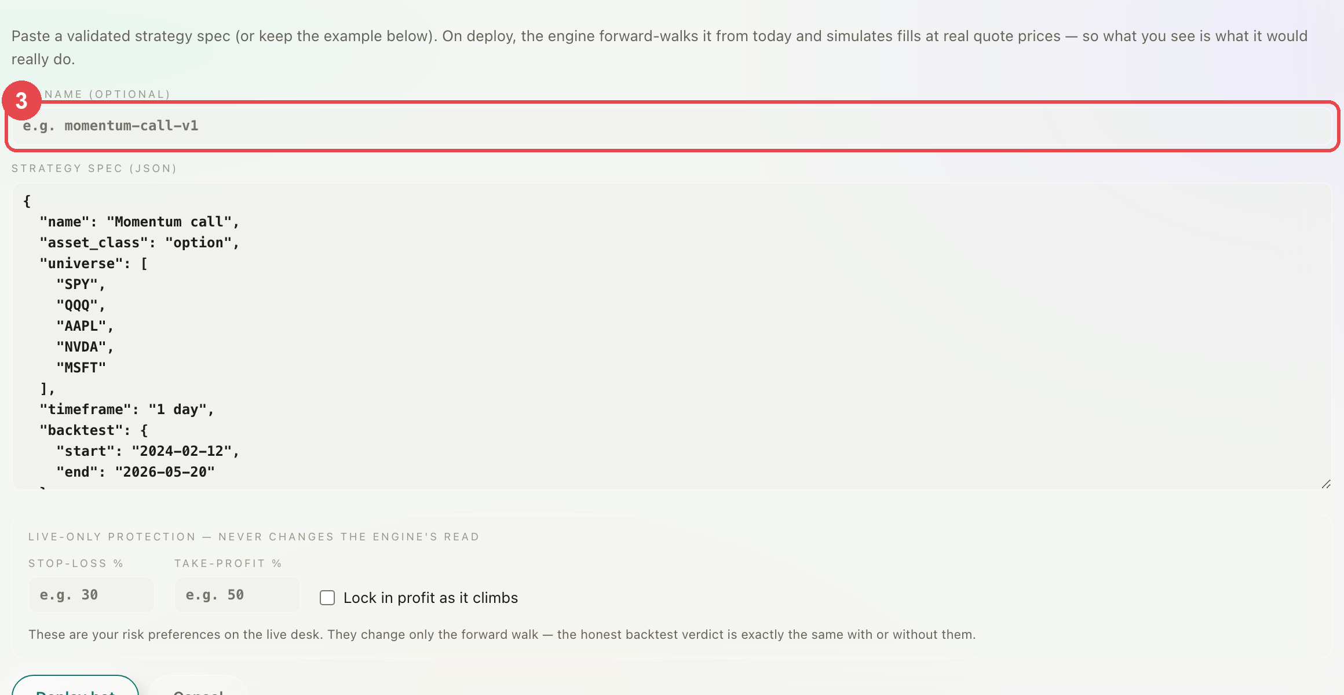
AFTER YOU DEPLOY
Deploying from the desk
STEP 3
You can also paste a bot straight onto a desk — and add a stop-loss.
Quantradin · Deploy your first bot
33 / 35

Slide 34
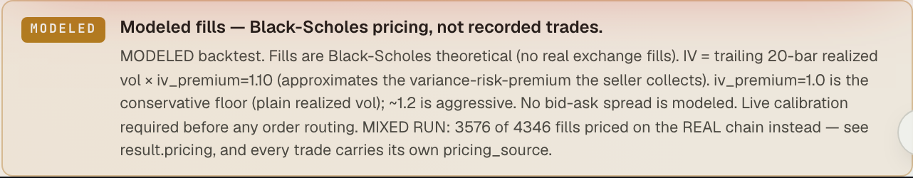
READ THIS BIT
The honest limits
Paper money only. Real option prices where they exist, a model where they don't — and it always says which. Fees are charged. Being assigned early is not modelled, so we tell you instead of guessing.
Quantradin · Deploy your first bot
34 / 35

Slide 35
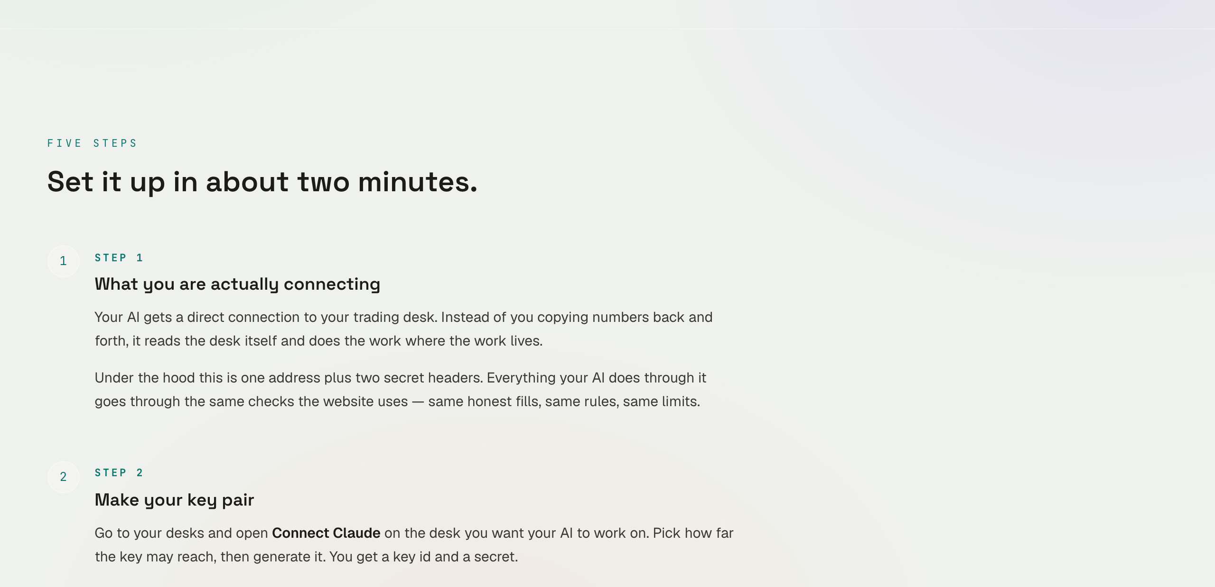
HELP
If you get stuck
quantradin.com/learn — short lessons and every indicator explained. quantradin.com/learn/connect-ai walks the AI setup. Or email support@quantradin.com.
Quantradin · Deploy your first bot
35 / 35

